Slide 1
DeepClue
John Rutledge, Brian Gilmore, Zoe Romo,
Nayana Ravi, Harshitha Ambilpur, Tallon Coxe

Slide 2
Motivation
The motive for this project was to take a fun approach to creating an AI agent that could make its own decisions based on autonomous actions and reinforcement learning.
A popular murder mystery game, Clue® was chosen for our agent to compete in, against 5 other players.
Interested in seeing how well the agent would perform in such a complex, strategic game.
Wanted to be able to play against the bot, and therefore would have a GUI implemented.

Slide 3
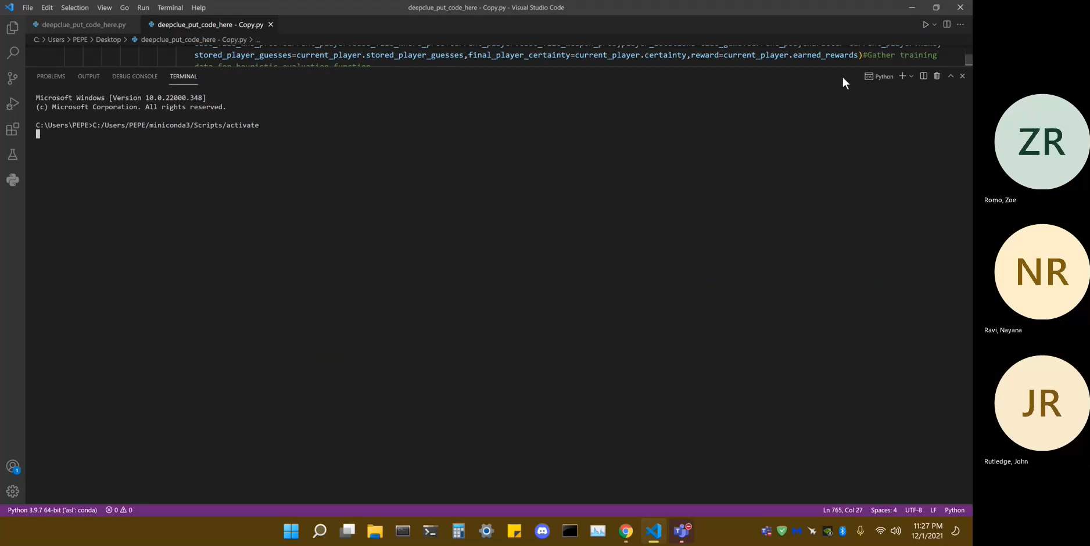
Demonstration

Slide 4

Demonstration

Slide 5
Design
Basic functions created for game set up and actions (environment, card distribution, dice roll, navigation, suggesting, accusing, etc.)
Functions storing information on probabilities, previous guesses made by other players, etc.
Functions were then inserted into classes, allowing each of the 6 players to perform and keep track of information equally and separately.
We implemented a neural network since the state space was too large for plain Q-learning. However, we were not able to get working results in our timeframe

Slide 6
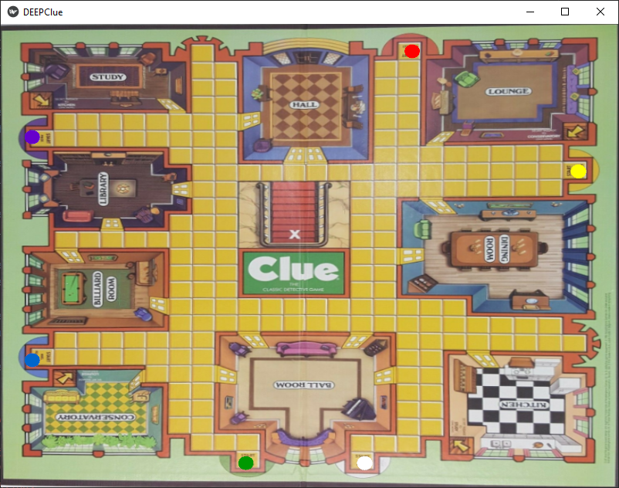
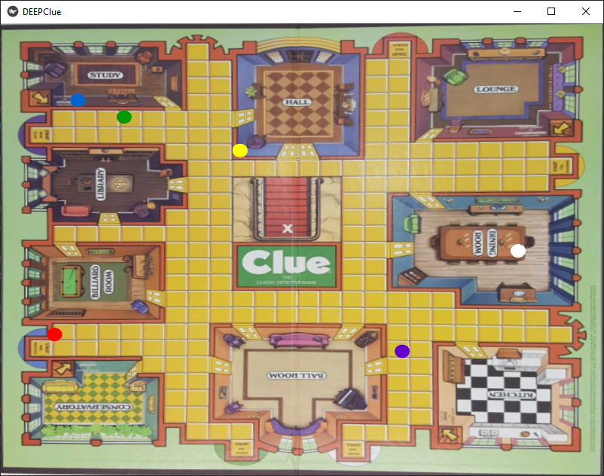
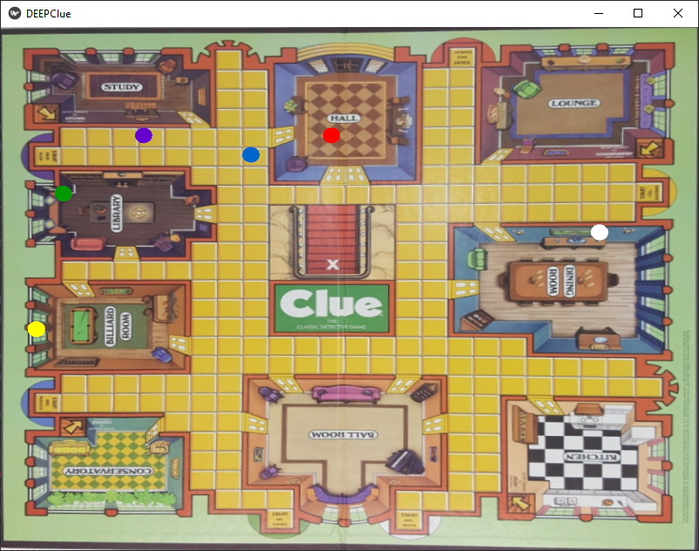
Design – Visual Gameplay
Initial game state
After one click
After two clicks
Use Clue® board picture as background
Colored circles represent players
Move players based on grid coordinates
Requires mouse click on board to get new sets of coordinates and update positions

Slide 7
Next
Further enhancement of reinforcement learning and training.
Add ability to play with/against deception.
Interface GUI with game code

